Slide 1

OPERATE A FAST FOOD OUTLET
D1.HCA.CL3.05
Notes:
Welcome students to the class

Slide 2

Operate a fast food outlet
Assessment for this Unit may include:
Oral questions
Written questions
Work projects
Workplace observation of practical skills
Practical exercises
Formal report from employer/supervisor
Notes:
Trainer to advise:
Trainer advises students that assessment for this Unit may take several forms all of which are aimed at verifying they have achieved competency for the Unit as required.
Trainer indicates to students the methods of assessment that will be applied to them for this Unit.

Slide 3
Operate a fast food outlet
This unit comprises five elements:
1
Plan for fast food production
2
Prepare, cook and hold items for fast food cooking
3
Provide fast food service
4
Maintain fast food outlet
5
Store food items
Notes:
Trainer to advise:
Trainer advises students this Unit comprises five elements, as listed on the slide explaining:
Each Element comprises a number of Performance Criteria which will be identified throughout the class and explained in detail
Students can obtain more detail from their Trainee Manual
The course presents advice and information but where their workplace requirements differ to what is presented, the workplace practices and standards must be observed.

Slide 4
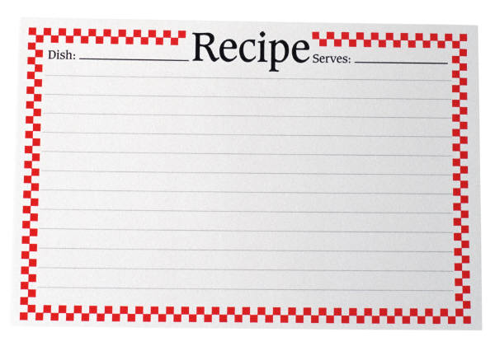
Operate a fast food outlet
Element 1: Plan for fast food production
Identify large and small equipment requirements for menu and volume
Identify staff requirements
Plan a menu to meet establishment and client requirements
Plan workflow and production schedules
Prepare standard recipes for menu items
Notes:
Trainer to advise:
Trainer to relate performance criteria to element 1
Performance criteria is the process by which the students training match the learning element
The element is the skill
To assess competency in the skill; the performance criteria is used to outline activities that can be used to assess competency.
The trainer should relate how the performance criteria is related to the element
To be able to Operate a fast food outlet the students must be able to; Plan for fast food production
The student should be able to do
Identify large and small equipment requirements for menu and volume
Identify staff requirements
Plan a menu to meet establishment and client requirements
Plan workflow and production schedules
Prepare standard recipes for menu items

Slide 5
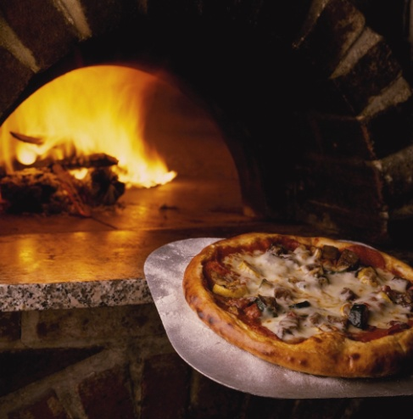
Operate a fast food outlet
Identify equipment requirements for menu and volume large and small
Type of fast food?
If pizza is not made then no large oven
If no chicken then no deep fryer
Different business means slightly different equipment.
Notes:
Trainer to advise:
Equipment will vary slightly as type of food produced
When does a fast food outlet become a café which then becomes a restaurant?

Slide 6
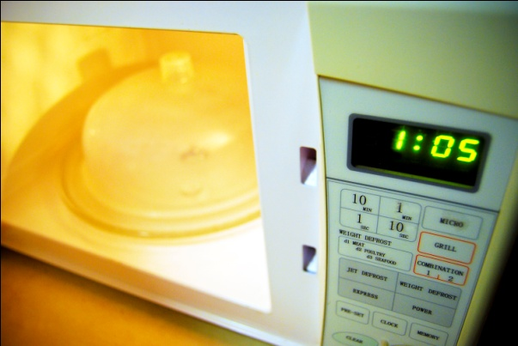
Operate a fast food outlet
Identify equipment requirements for menu and volume large and small
Cooking equipment:
Stoves
Microwaves
Grills
Deep-fryers
Notes:
Trainer to advise:
Safe operating of equipment makes working much easier
Staff trained in all aspects

Slide 7
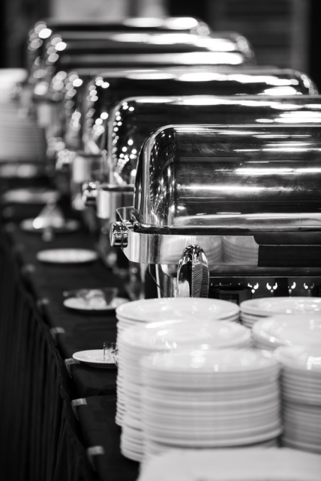
Operate a fast food outlet
Identify equipment requirements for menu and volume large and small
Large equipment:
Exhaust range hood
Refrigerator
Dishwasher
Cold display cabinet
Hot display bain-marie
Notes:
Trainer to advise:
Exhaust range hood to extract hot air from kitchen is an expensive equipment purchase.
Expensive to install and expensive to remove if business does not succeed.
Exhaust hoods are mandatory where gas is used as a fuel for cooking.
If flame is extinguished then there is no build up of poisonous gases
Large equipment used to store foods and clean dishes

Slide 8
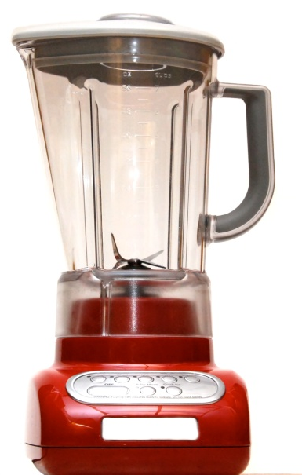
Operate a fast food outlet
Identify equipment requirements for menu and volume large and small
Small equipment:
Food processor
Blender
Knives
Storage trays
Consumables
Notes:
Trainer to advise:
Small equipment used to process foods
Variety will differ slightly depending on style of food outlet.
Some outlets will purchase all commodities from larger suppliers and assemble as required
This will reduce the amount of infrastructure and equipment required.
Equipment like
Storage trays and consumables will always be required
Consumables are items such as
paper bags
Take away supplies
Plastic wrap for covering foods
Aluminum foil for covering hot foods

Slide 9
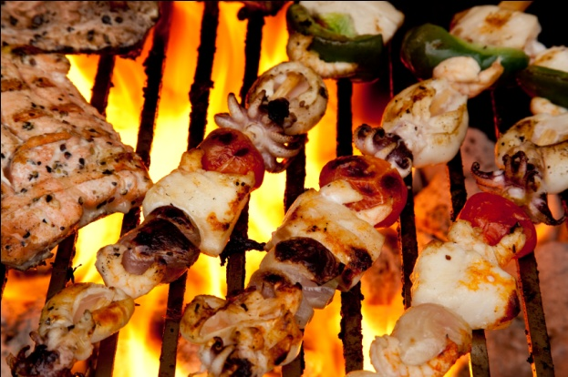
Operate a fast food outlet
Identify staff requirements
Good presentation skills
Good customer skills
Excellent product knowledge
Good hygiene practices
Good work ethic
Notes:
Trainer to advise:
Employing good staff is challenging
Staff should present well to customers
They should be able to engage with customers and give customers a pleasant experience
Staff should have good product knowledge of menu items
Staff should have a good work ethic

Slide 10
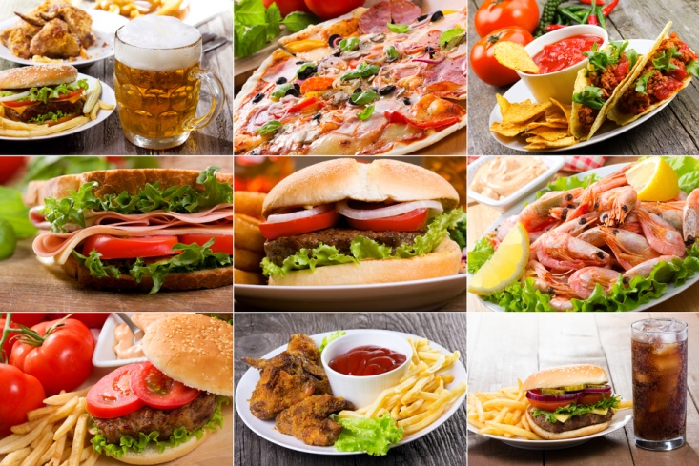
Operate a fast food outlet
Plan menu to meet establishment and client requirements
Style of food
Number of food items
Client requirements
Establishment requirements
Business success
Notes:
Trainer to advise:
Planning menu to meet establishment and client requirements
Style of food
When the style of food has been decided then the menu needs to reflect that style.
Menu can have slight variations of style but should be true to form
Number of food items
Number of menu items need to be kept to minimum
If pizza is the main style of fast food then do not do burgers
10- to 16 pizza is sufficient; meat based and vegetarian
Drinks also kept to minimum
If coffee is offered and you sell espresso then you may need to employ 1 person just to make coffee
Client requirements?
What do clients need? If there are 6 businesses selling pizza then the customers do not need another pizza place
Clients do not need a large choice when ordering fast food
Student activity: Ask students why not? For previous statement.
It takes the client longer to order if the menu is too large
If the menu is large then there is more mise en place required in the kitchen
More staff required
possibility of more waste
Slower service
Establish requirements?
Quick turnover of clients
Quick sales
Maximum profit from lower costs
Business success
All comes from above

Slide 11

Operate a fast food outlet
Plan workflow and production schedules
Commodity intake
Ingredient processing
Dish construction
Service to customers
Notes:
Trainer to advise:
Planning the workflow is about how much has to be done to the commodity after is comes onto the premises
How many elements or parts to each dish
The more processing required the greater the workflow planning required
Dish or menu item construction will always have to be carried out
The number of ingredients that make up the dish will determine the time this steps takes
10 elements take longer than just 4
Service to customers is always the same.
It takes as long to conduct the sale of 20 items to a customer as it does to sell one item
Cleaning after end of business will always have to be done.

Slide 12
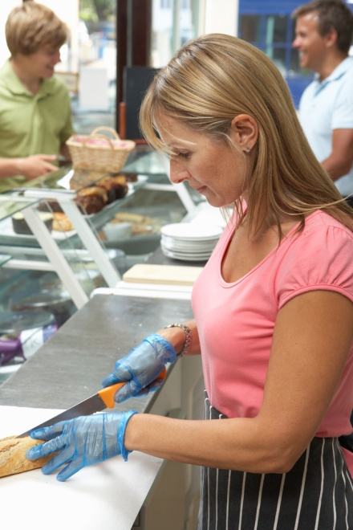
Operate a fast food outlet
Prepare standard recipes for menu items
How many elements to dish? (Sample for burgers)
Bun
Pattie, meat, fish, chicken
Lettuce
Pickles
Sauce
Wrapping and packaging
Notes:
Trainer to advise:
Standard recipes should always produce the same product anywhere in the world that it is used.
There is a famous burger chain that has proved this to be correct.
The more elements the higher the cost of ingredients and higher cost of labour because it takes longer to construct.
This process needs to be implemented for any menu item
Student Activity
The students need to produce a standard recipe for any fast food they can think.
List the elements of the purchased product
Pizza?? Dough, sauce, toppings 1 or 5, how much of each, how much cheese
Cooking time
Packaging requirements
Same process for chicken or curry bar selection

Slide 13
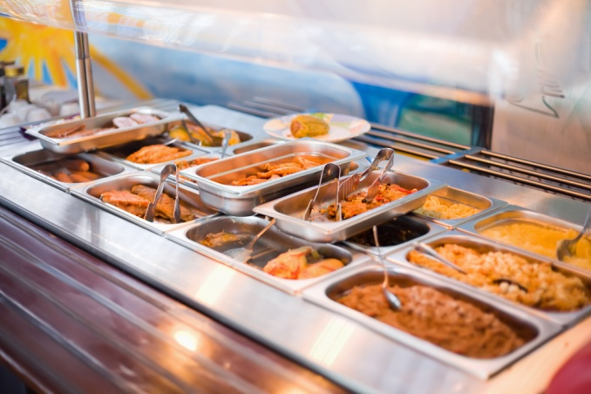
Operate a fast food outlet
Element 2: Prepare, cook and hold items for fast food outlet
Set appropriate preparation and cooking methods
Use appropriate equipment
Follow food safety requirements
Hold menu items
Reheat menu items
Notes:
Trainer to advise:
Trainer to relate performance criteria to element 2
Performance criteria is the process by which the students training match the learning element
The element is the skill
To assess competency in the skill; the performance criteria is used to outline activities that can be used to assess competency.
The trainer should relate how the performance criteria is related to the element
To be able to Operate a fast food outlet the students must be able to;
Prepare cook and hold items for fast food outlet
The student should be able to:
Use appropriate preparation and cooking methods
Use appropriate equipment
Follow food safety requirements
Hold menu items
Reheat menu items

Slide 14

Operate a fast food outlet
Use appropriate preparation and cooking methods
Cooking?
How much is required for each venue?
Curry shop
Burger shop
Fish shop
Salad shop
Notes:
Student Activity 1:
Ask how much cooking is required for each shop
Ask them to list in order of which place might have the most cooking requirements
Student Activity 2:
Ask how much cooking is required for each shop
Sample answer could be this
Burger and fish shop will be equal if just the flesh is to be cooked
If fries are to be offered then that business goes to the higher cooking requirements
Curry bar can purchase all curries in and therefore only has to re-heat, no cooking required
Curries can be reheated in microwave
Salad shop has no cooking requirements; all commodities can be purchased from suppliers

Slide 15
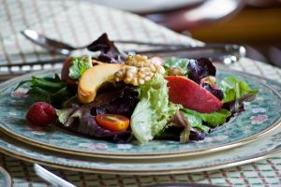
Operate a fast food outlet
Use appropriate preparation and cooking methods
Salad preparation
How much is required for each venue?
Washing of base salad leaves
Preparation of some vegetables
Preparation of dressings
Assemble base variety for display
Notes:
Trainer to advise:
Student Activity:
Each menu item will have specific requirements to be carried out before that menu item is ready for sale
A timeline will be need to be developed so decisions can be made as the viability of such menu items
It will vary depending on how enterprise is set up

Slide 16
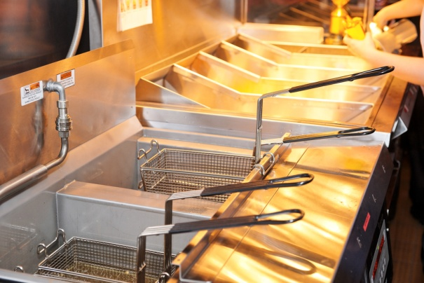
Operate a fast food outlet
Use appropriate equipment
Lots of cooking
Minimal cooking
Stove
Oven
Deep fryers
Grillers
Notes:
Trainer to advise:
How the business is set up will determine what equipment is required
Train staff in proper usage of all equipment
Use equipment suitable for the job
If there is going to be lots of deep frying then purchase several large deep fryers
Small ones will not recover heat quick enough to keep up with pace of cooking required
One large one is not sufficient because if it fails to operate then there is no backup and then you have no business
Keep equipment clean and well maintained

Slide 17

Operate a fast food outlet
Follow food safety requirements
Food Safety Plan operation requirements
Keep records
Temperature checks
Process flow checks
Train staff
Purchase from Approved Suppliers
Notes:
Trainer to advise:
All business must operate with a food safety plan
Food safety plans outline the steps that are being followed by the business to keep food safe for human consumption
If staff are trained in these requirements and staff follow the required steps then food produced will be safe to eat.
A food safety plan is designed to minimise the possibility of causing any adverse reaction in people who consume the food
It is not a guarantee

Slide 18
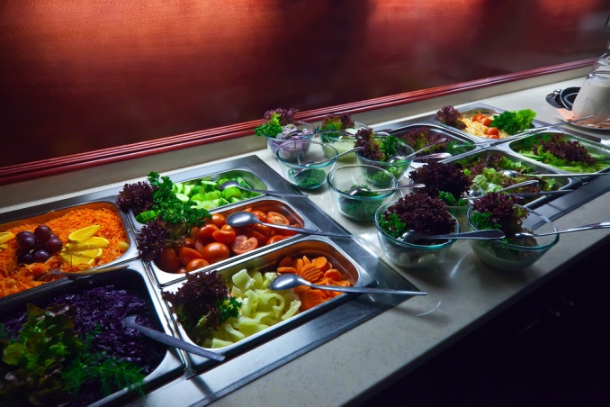
Operate a fast food outlet
Hold menu items
Keep hot
Keep cold
Keep at room temperature
Notes:
Trainer to advise:
Hold is a term to describe the time between when the food has been cooked until it is delivered to the customer for eating.
In a curry shop the curry is cooked and held hot in a Bain Marie to keep it hot until a customers requests a serve
If it was a salad shop then the salad will have to be kept chilled with no dressing until sold so the leaves remain crisp.
The salad has been ‘held” in a suitable state

Slide 19

Operate a fast food outlet
Reheat menu items
Re-heat as required
Re-heat to a temperature required quickly
Reheat high risk foods to temperature stated in Food Safety Plan
70°C is the recommended temperature
Notes:
Trainer to advise:
If food has been precooked as part of the production schedule then it only needs to be reheated for service
Reheat only what is required
Reheat high risk foods to at least 70°C

Slide 20

Operate a fast food outlet
Element 3: Provide fast food service
Serve and present food items in line with customer volume
Maintain a clean customer service area
Notes:
Trainer to advise:
Trainer to relate performance criteria to element 3
Performance criteria is the process by which the students training match the learning element
The element is the skill
To assess competency in the skill; the performance criteria is used to outline activities that can be used to assess competency.
The trainer should relate how the performance criteria is related to the element
To be able to Operate a fast food outlet the students must be able to; Provide fast food service
The student should be able to do
Serve and present food items in line with customer volume
Maintain a clean customer service area

Slide 21

Operate a fast food outlet
Serve and present food items in line with customer volume
Speed of service
Quality of service
Quantity of serving consistency
Special requests for changes to standard menu items
Customer satisfaction
Notes:
Trainer to advise:
When serving fast food there is going to be peaks and troughs in customers requiring product
Process can be achieved when there is no pressure
But can process quality be maintained when pressure to serve more customers in timely manner still be achieved.
People are not machines. They can only do so much in a certain time
With practice and proper equipment efficiencies can be achieved
Sometimes more staff have to be added
Sometime better equipment may be needed
Depending where the weak point in the process is happening
Staff may be very good but if equipment is 2nd rate then service cannot be improved
If equipment is the best and staff are struggling then extra staff can make it work better

Slide 22
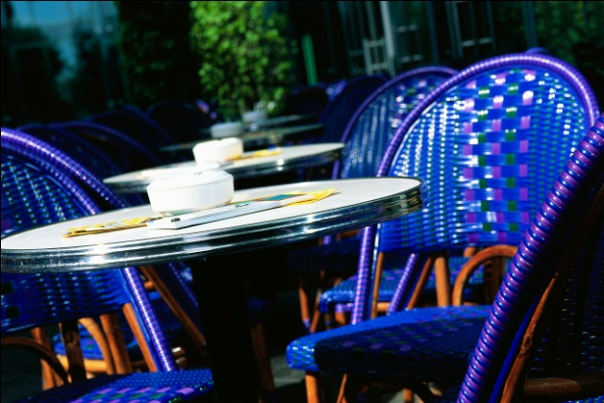
Operate a fast food outlet
Maintain a clean customer service area
When customer movement is slow; clean; clean; clean
If customer service is constant; serve; clean; serve
If customer service is very busy; serve; serve; clean; serve
After customers have gone; clean; clean; clean
Notes:
Trainer to advise:
The customer service area is where the customers interact with the business
What the customers see here is their perception of the enterprise
It does not matter how much money is spent on advertising to say that the stores are cleanest in the city
What the customers see is what they will think
Keep the customer service area clean at all times
Both front of counter and behind counter
Keep all areas of food enterprise clean
Remember
The biggest burger chain in the world rates cleaning of premises at the same level as quality of product that it sells.

Slide 23

Operate a fast food outlet
Element 4: Maintain fast food outlet
Clean fast food area in line with establishment and equipment requirements
Undertake stock control and reordering processes
Identify and report maintenance issues to appropriate personnel
Notes:
Trainer to advise:
Trainer to relate performance criteria to element 4
Performance criteria is the process by which the students training match the learning element
The element is the skill
To assess competency in the skill; the performance criteria is used to outline activities that can be used to assess competency.
The trainer should relate how the performance criteria is related to the element
To be able to Operate a fast food outlet the students must be able to; Maintain fast food outlet
The student should be able to do
Clean fast food area in line with establishment and equipment requirements
Undertake stock control and reordering processes
Identify and report maintenance issues to appropriate personnel

Slide 24
Operate a fast food outlet
Clean fast food area in line with establishment and equipment requirements
Food Safety Plan – cleaning schedule:
Hourly
Twice daily
Daily
Weekly
As required
Notes:
Trainer to advise:
Cleaning is integral part of the smooth operation of a fast food outlet
As stated; cleanliness of premises is how customers will rate quality of product
Nobody buys from dirty food premises
Even their own kitchens may not be as clean, that is why they come to you
Food safety plan must have a cleaning schedule
What is to be cleaned; when it is to be cleaned; who is to clean; with what it is to be cleaned; how often it is to be cleaned
And when it has been cleaned on the hour every hour for the last 6 hours and some body has accident, then it is to be cleaned immediately to the required condition and standard; AS REQUIRED mean just that

Slide 25

Operate a fast food outlet
Undertake stock control and reordering processes
Par stock level
Accounting for all stock purchased
Against goods sold
Number of sales
Re order to par stock levels
Notes:
Trainer to advise:
Carrying too much stock is a strain on money invested in business
Determine par stock levels
This is minimum stock required to match expected sale of product
There should always be allowances for extra sales
Lost sales is lost revenue and lost growth of business
If you have par stock of 15
Sale average around 12
Sometimes 9; sometimes 14
So the buffer for extra sales is 25% extra stock
If 11 are sold then then 11 are ordered to make back up to 15
When there is a surge in sales and they exceed 15 then next order is for 20
If sales drop then less can be ordered next time but if sales increase and stay increased then you have stock to make sales

Slide 26

Operate a fast food outlet
Identify and report maintenance issues to appropriate personnel
Repair any defect as needed:
Broken microwave
Broken floor tile in bathroom
Broken electrical wiring
Notes:
Trainer to advise:
Defective equipment and amenities area are inefficient and dangerous to the health of the business
Equipment that is not working will slow down working potential of staff and speed of service
A broken floor tile is dangerous to customers and staff
No staff; no production
Injured customers; no business

Slide 27
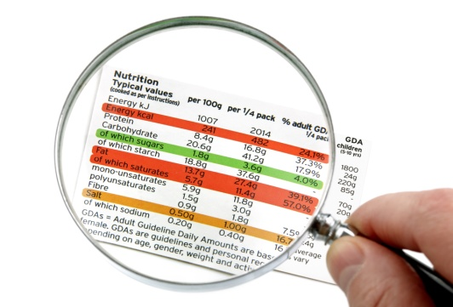
Operate a fast food outlet
Element 5: Store food items
Store fresh and or vacuum packed items correctly
Prepare and maintain correct thawing of food items
Store fast food products appropriately in correct containers
Label fast food products correctly
Ensure correct conditions are maintained for freshness and quality
Notes:
Trainer to advise:
Trainer to relate performance criteria to element 5
Performance criteria is the process by which the students training match the learning element
The element is the skill
To assess competency in the skill; the performance criteria is used to outline activities that can be used to assess competency.
The trainer should relate how the performance criteria is related to the element
To be able to Operate a fast food outlet the students must be able to; Store food items
The student should be able to do
Store fresh and/or vacuum packed items correctly
Prepare and maintain correct thawing of food items
Store fast food products appropriately in correct containers
Label fast food products correctly
Ensure correct conditions are maintained for freshness and quality

Slide 28

Operate a fast food outlet
Store fresh and or vacuum sealed items correctly
Cold storage:
Temperature of less than 5°C
Vacuumed sealed products in single layer in separate tray
Keep cooked and uncooked separate
keep all foods covered
Label all product
Notes:
Trainer to advise:
Three food storage areas in a food store selling food to customers
The other storage area is for chemical; no food or product used with the food is to be stored in chemical store.
Dry store is for food that can stand at room temperature
Fresh product needs to be chilled to lessen potential growth of bacteria and to extend the ‘life’ of the product
Rate of decomposition is less when temperature is reduced
Keep everything covered
Label all products for easy identification

Slide 29
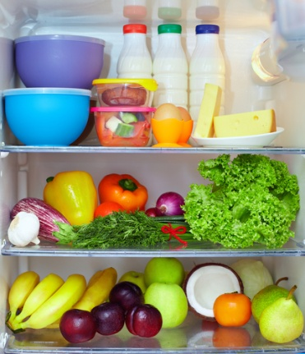
Operate a fast food outlet
Prepare and maintain correct thawing of food items
Separate container
Keep in coolroom until thawed
Use as soon as thawed
Notes:
Trainer to advise:
Best place to thaw frozen product is in clean container large enough to hold any liquid that comes out of product when frozen state has ceased.
Coolroom that has temperature of less than 5°C
Use product as quickly as possible
Thawed food does not have the same life span as when it was fresh.

Slide 30
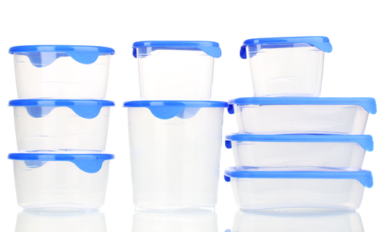
OPERATE A FAST FOOD OUTLET
Store fast food products appropriately in correct containers
Food grade containers
Good state of repair
Clean
Able to seal
Notes:
Trainer to advise:
All food needs to be stored in containers suitable for the task
Stainless steel is best but good quality plastic. that is durable able to protect the food and will not contaminate food with compounds from plastic. is acceptable
Always, containers must be clean before using to put other food in.
Containers must be able to be sealed; edges will not cut plastic wrap when it is used to seal container

Slide 31

Operate a fast food outlet
Label fast food products correctly
Name of the product
Date of manufacture
Use by date
Name of person who produced food
De-cantered food ingredients
Notes:
Trainer to advise:
Food stored in coolroom
All foods stored in coolroom need to be labeled correctly
Food de-cantered from tins and boxes and placed into new clean containers needs to be labeled correctly

Slide 32
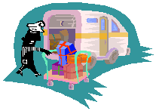
Operate a fast food outlet
Ensure correct conditions are maintained for freshness and quality
Purchase only what is required for purchasing cycle
Buy in small amounts
Keep fresh foods chilled
Keep foods covered with protective covering
Notes:
Trainer to advise:
To ensure freshness in foods it is good practice to purchase in small amount depending on rate of usage
Keep fresh foods chilled to keep bacterial growth to minimum and rate of decomposition to minimum.
Keep covered to keep foods moist.

